Slide 1

H HEUER INSTRUMENTS
Based in Sydney, Australia since 1975.
Design and Manufacture of Telecom Test Equipment.
Customer base includes major Telcos, Energy & Power utilities, Infrastructure (Road / Rail / Air), Emergency Services and many others.
Export worldwide

Slide 2
LT51 Applications
The LT51 Line Tester is a light weight, handheld, battery powered unit suitable for testing in many applications.
200 to 2.2 MHz Bandwidth for VF /Audio and RF analog testing
RF (2 kHz-2.2 MHz) testing of Power Line Carrier (PLC) or xDSL or RF interfaces.
VF (200 Hz to 4 kHz) testing of the PSTN, analog FXS and FXO interfaces of digital exchanges, PCM muxes, microwave radio links or PLC.
Can replace both W&G SPM-3x and PS-3x.

Slide 3
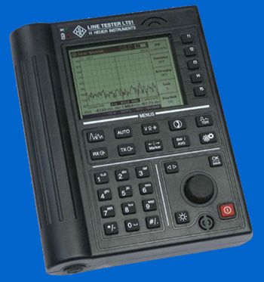
LT51 Line Tester
DC Power LED
Speaker
Charging LED
Soft Keys for menu selection
320x240 LCD
Configuration Menu keys
Measurement Menu keys
Save / Enter key
Knob for cursor, parameter entry, Volume
Keypad for dialling and parameter entry
On/Off key
Microphone for speakerphone
Battery access
Backlight control

Slide 4
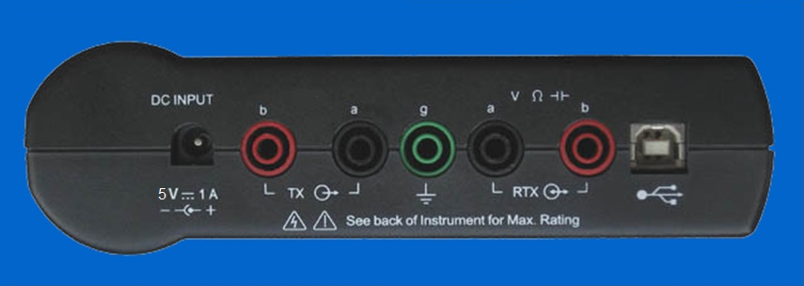
LT51 Connectors
AC/DC Charger
Ground
USB socket for PC connection
Transmit signals on this pair
Receive and transmit on this pair, DMM, TDR functions

Slide 5
LT51 features
Selective Level Meter
Spectrum Analyser with zoom
Level Generator (totally independent operation)
DMM - AC/DC voltage, Loop current, nF and Ω
Return Loss / Impedance Meter
Balance Meter
TDR
POTS – Ring detect, DTMF dialling, handsfree voice

Slide 6

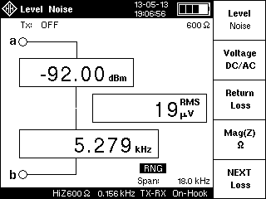
LT51 Operation
Press the red key to toggle the LT51 ON / OFF.
To force unit OFF, press and hold the key > 5s.
Default setup:
  Separate receiver / transmitter (TX-RX setting or 4-wire)
  Transmitter off
  600 Ω impedance
  Receiver input: bridging
  Receiver Span: 0 – 4.5 kHz
  Total RMS (noise + tones)
  across 4.5 kHz displayed

Slide 7

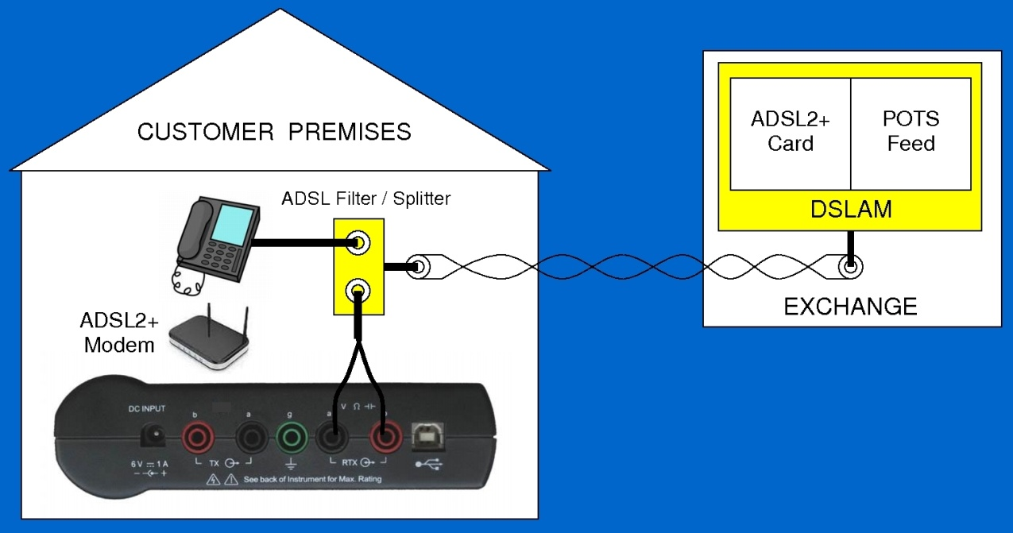
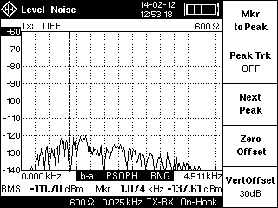
Level measurement
Connect the signal to measure to the RTXa-b terminals.
Press the key and set the input impedance by toggling [f1]. Set bridging or terminated, by toggling [f2]
Press [f3] to set auto-range to LVL only.

Slide 8
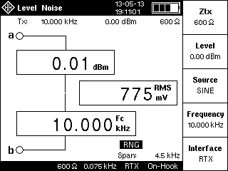
Selective Level Meter
Measure level at any frequency from 200 Hz - 2.2 MHz
Press key then [f1]
to select “Level Noise”.
Press key, then [f2]
to set the Centre frequency.
By default the BW is set to 25Hz
for level measurement.
Press [f3] to select a BW of 1.74 or 3.1 kHz for noise measurement.
Cancel Selective mode, by setting BW to “Wide”

Slide 9
Spectrum Analyser
Zoom in on any frequency up to 2.4 MHz
spans from 4.5, 9.0, 18.0 to 600 kHz, 1.2 & 2.4 MHz
Set up as for Selective Meter, then press key
Use marker to selectively measure level of peaks
Total RMS across span BW (all peaks) is also displayed

Slide 10
Level Generator
Press the key to change the TX parameters.
Set the output impedance by toggling [f1].
Press [f2] to set the TX level and either use the knob or directly enter a value from -60 to +10 dBm.
Set the TX frequency by pressing [f4], and either use the knob or directly enter a value from 200 Hz to 2.2 MHz.
Press [f3] to toggle the output of a tone SINE or OFF,
Press [f5] to sweep across the set span BW.
Press the key, then [f5] to control whether the tone is output on the Txa-b (TX-RX or 4W mode) or RTXa-b (RTX or 2W mode) terminals.

Slide 11
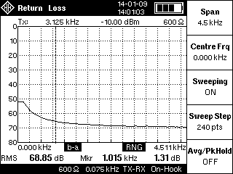


Return Loss
Connect the impedance / circuit
to measure to RTXa-b.
Press or key then [f3]
to select Return Loss.
Press key, then [f1] to
setup return loss ref. impedance
Press [f4] to set the frequency,
and either use the knob or directly
enter a value from 200 Hz to 2.2 MHz.
Press [f5] to sweep across span BW.

Slide 12
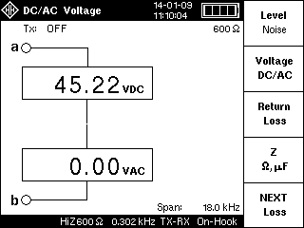
DC or AC Voltage
Measure upto ±60 Vdc, 33Vrms/ac
Connect the pair to the RTXa-b terminals.
Press the key, then press [f2] to select “Voltage”.
.

Slide 13

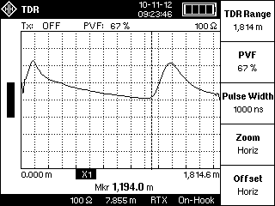
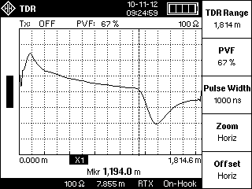
Line Continuity - TDR
TDR is ideal for locating Loop short and open circuits.
Press button for Auto-TDR.
Use cursor for distance to fault.
open
short

Slide 14
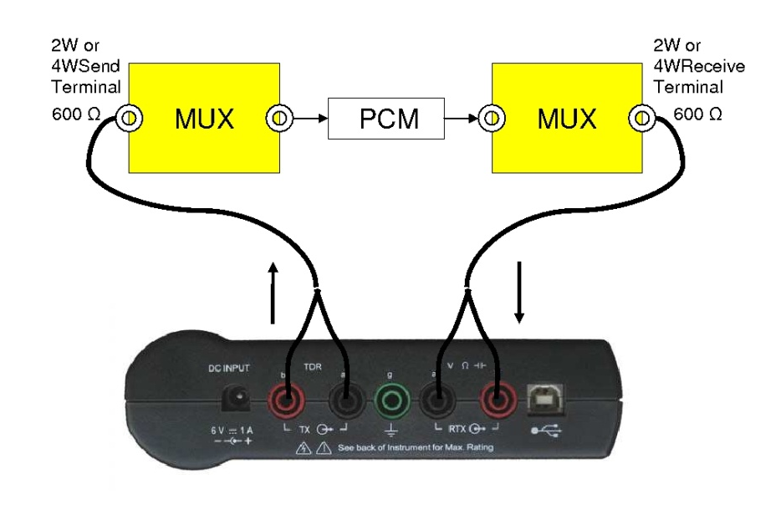
VF Testing (eg. PCM MUX)
Check:
  Idle Channel Noise
  Audio Level Setting
  Frequency Response
  Variation of Gain with input
  level
  Signal to Quantisation Noise
  Cross Talk
  Ring Detect VAC & VDC
  while on-hook
  VDC & IDC when off-hook

Slide 15

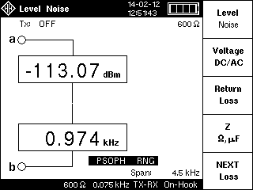
VF Testing (eg. PCM MUX)
Idle Channel Noise
  Press , then [f3] to set the BW to “PSOPH” if required.
  With or without Psophometric weighting
  See User Manual for further set-up options

Slide 16
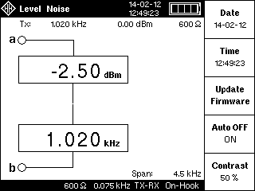
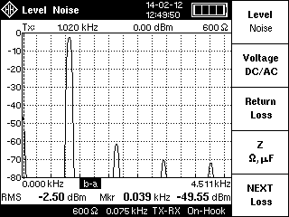
VF Testing (eg. PCM MUX)
Audio Level Setting
Use LT51 default setting ( then [f2] to set TERM)
Measure level of received audio tones
See User Manual for details on setting transmitter

Slide 17
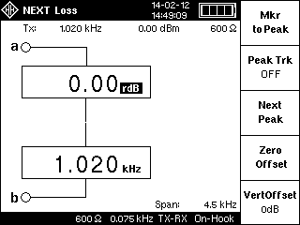
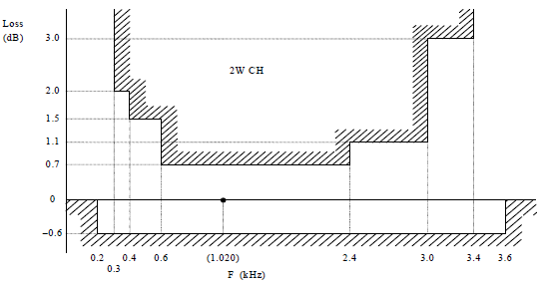
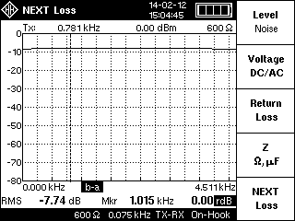
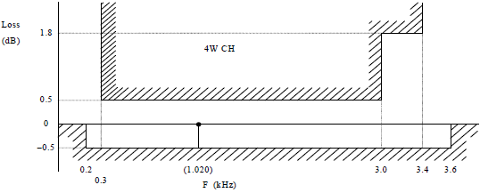
VF Testing (eg. PCM MUX)
Frequency Response
  Single or swept frequency

Slide 18
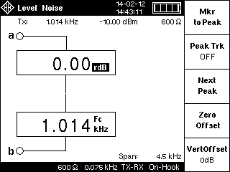

VF Testing (eg. PCM MUX)
Variation of Gain with Input Level
See User Manual for details

Slide 19
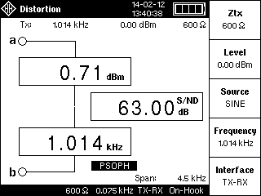
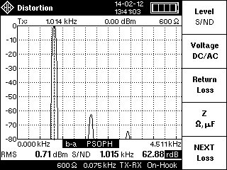
VF Testing (eg. PCM MUX)
Signal to Quantisation Noise
  With or without Psophometric filter
  See User Manual for details

Slide 20
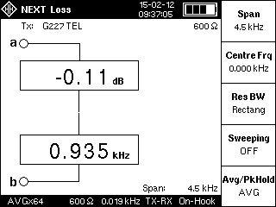
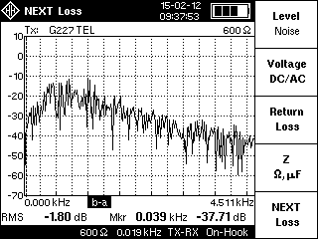
VF Testing (eg. PCM MUX)
Measure Crosstalk in adjacent PCM channels
  Transmit built-in G.227 Telephone Noise signal
  Span = 4.5 kHz, ZRTX = 600
  See User Manual for details

Slide 21
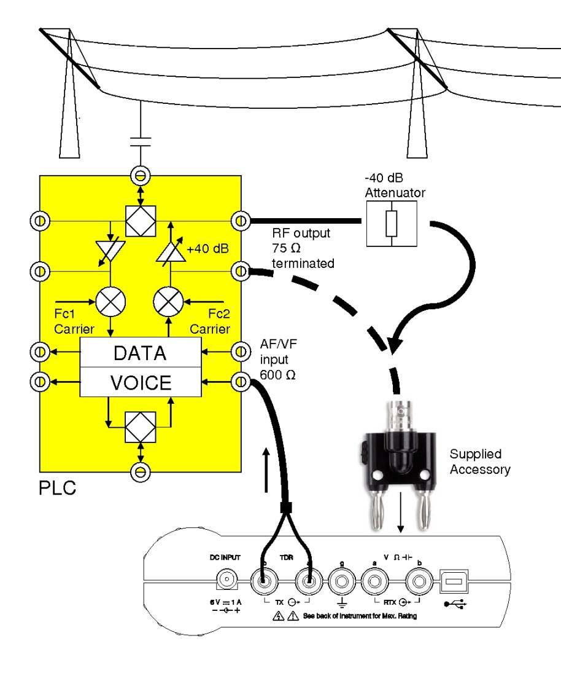
RF Testing (eg. SSB PLCC)
Transmit VF tone
at 600 ohm from LT51 TXab
into PLCC VF terminal.
Measure RF modulation of
tone onto 500 kHz Carrier
using 50/75 ohm at
LT51 RTXab receive input.
(using supplied BNC Adaptor
to interface to coax)

Slide 22
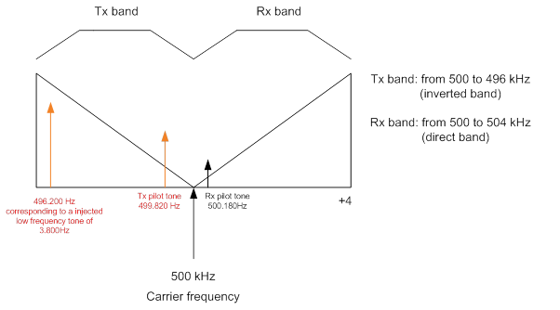
PLCC Testing (cont.)
Possible RF Frequency Spectrum for SSB PLCC System
Press then [f2] to set LT51 centre freq. to 498 kHz

Slide 23

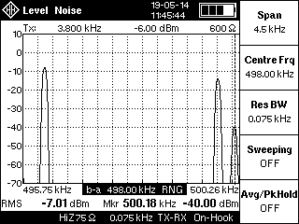
PLCC Testing (cont.)
Typical levels for 3 PLCC SSB frequencies:
* reception level is attenuated by 28dB ± 2 dB
Press to display the frequency spectrum on the LT51
Press [f1] to set the Span to 4.5 kHz for 3 SSB freq.s.
 | Frequency (Hz) | Theoretical level | Measured levels (with 40 dB attenuator)
Tx pilot | 499820 | +26 dBm | -14.00 + 40 = +26 dBm
Rx pilot | 500180 | 0 ± 2 dBm* | -40.00 + 40 = 0 dBm*
External tone (3800 Hz) | 496200 | +32 dBm | -7.98 + 40 = +32 dBm

Slide 24
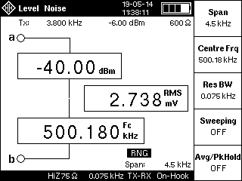
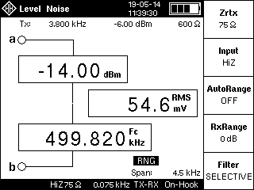

PLCC Testing (cont.)
Press to show level at 3 SSB frequencies
Press then
[f2] to set centre
frequency to each SSB frequency.

Slide 25
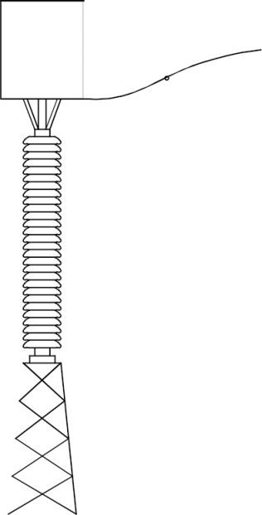
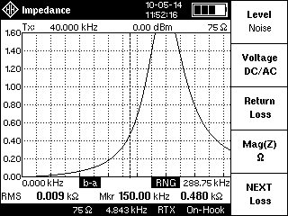
To Disconnector in OPEN position

Slide 26
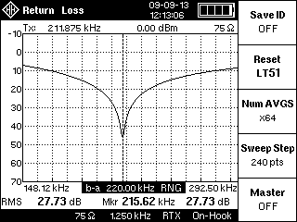
Return Loss of Coupling Device
Make single/swept freq’ncy measurements of the Return Loss of Coupling Devices or Line Matching Units (LMUs).
Fully automatic measurement with LT51 built-in bridge (no need for external bridges, 0 Ω generator).
Eg. Tuning of LMU (against 75 Ω) to ensure the high frequency carrier signals are sufficiently coupled to the transmission line.
Return Loss should be
> 12 dB over the carrier
freq. BW of interest.

Slide 27
Save / Recall Measurements
Any current measurement is stored by pressing the key:
  no file system or file names to enter.
  an optional SMS ID string can be attached.
  new results overwrite oldest stored results.
Recall measurements by pressing the key followed by [f1].
Use the knob to select the saved measurement and press [f3] to display the results on the LT51 screen.
Upload measurements to PC using LT51View utility.

Slide 28
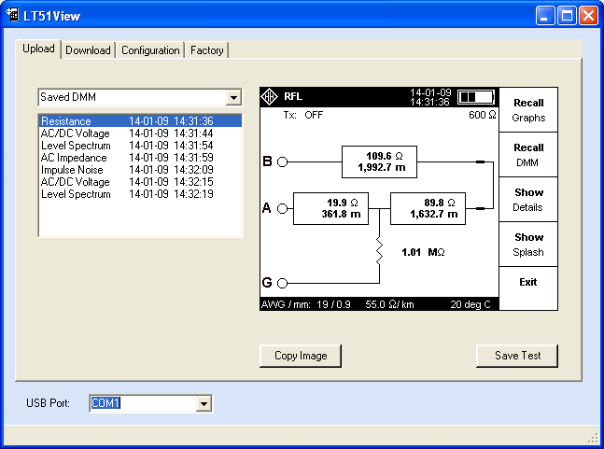
PC Interface
LT51View utility has simple interface for -
  Uploading saved results.
  Download new firmware.
  Remote control via single
  commands or script files

